Slide 1
Literature Review on Fingerprint Recognition Methods
Feature Extraction and Classification Techniques
Lance Heinrich
11/27/2024

Slide 2
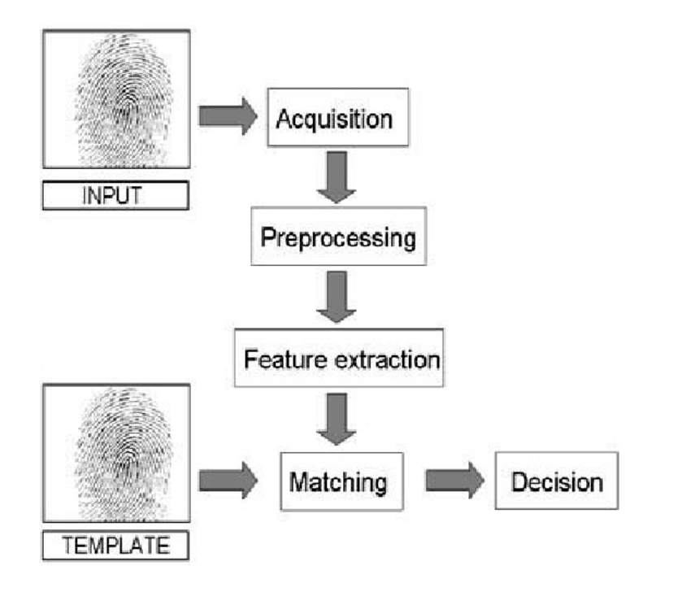
Introduction
Fingerprint Recognition in Biometrics
Fingerprint recognition is a foundational technology in biometric authentication due to its uniqueness and reliability.
There are two essential feature extraction techniques we will discuss: minutiae-based and texture-based methods.
Then we will discuss two common classification methods: including Support Vector Machines (SVM) and k-Nearest Neighbors (k-NN).
Purpose of the Review
To examine the strengths and limitations of these methods and highlight their performance in practical applications.
To understand the implications of choosing one technique over another based on evaluation metrics such as accuracy, sensitivity (TPR), and error rates (FPR).

Slide 3
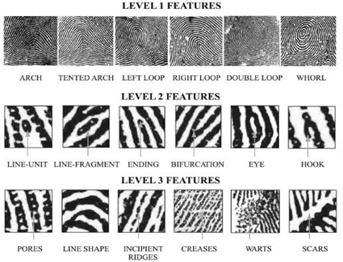
Overview of Minutiae-Based Feature Extraction
Challenges
What Are Minutiae?
Minutiae-based extraction can be sensitive to noise, skin conditions, and poor-quality images, which can affect the reliability of the system [1][3].
Techniques that bypass the traditional thinning process and work directly with gray-scale images have been explored to improve efficiency and accuracy [2][4].
Minutiae are the distinctive points in a fingerprint that include ridge endings and bifurcations.
These points are critical for differentiating individual fingerprints and are widely used in fingerprint matching systems.
Importance in Fingerprint Recognition
Minutiae-based methods are the backbone of many fingerprint recognition systems due to their high precision in feature extraction.
Effective minutiae extraction requires preprocessing steps such as binarization, thinning, and noise removal to ensure accurate identification.

Slide 4
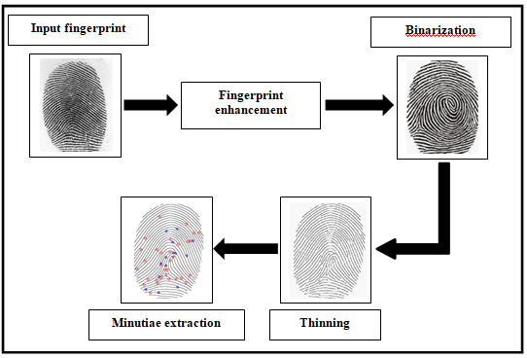
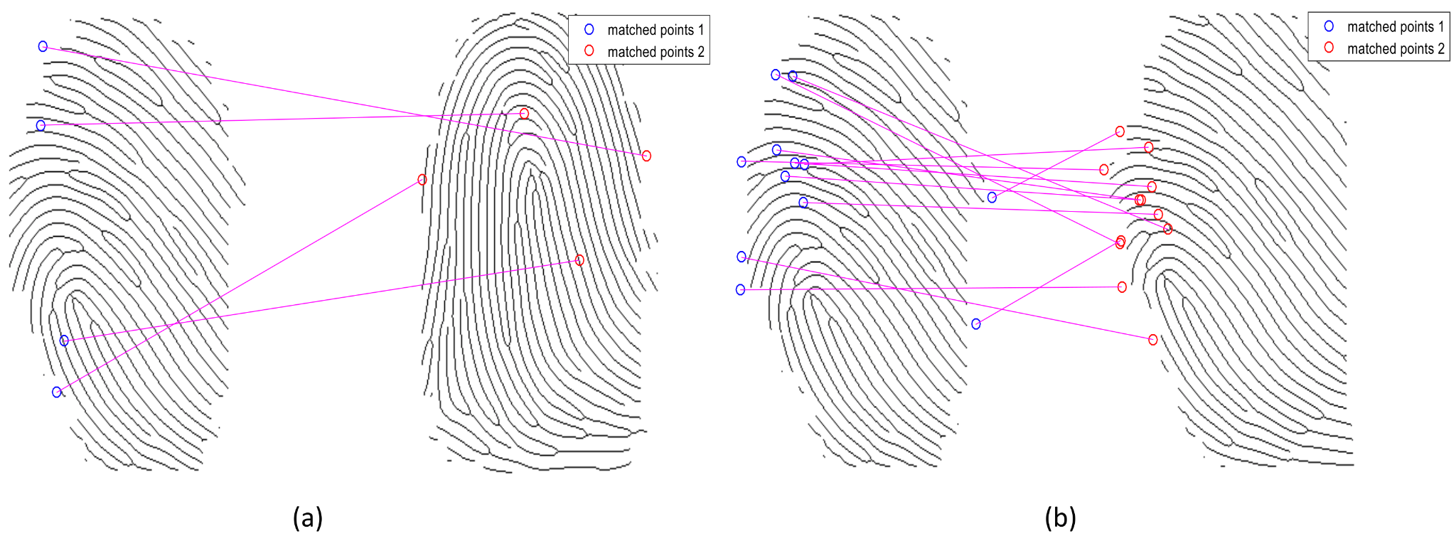
Advanced Minutiae-Based Methods
Improving Minutiae Extraction
Enhanced Precision
Traditional Extraction
Traditional minutiae extraction often involves thinning and binarization processes, but new techniques aim to improve accuracy and efficiency by working directly with gray-scale images[1][2].
Advanced approaches combine SURF (Speeded-Up Robust Features) and Harris corner detectors for more reliable extraction, especially in challenging, low-quality fingerprint datasets[3][4].
Integrating these advanced methods can mitigate the challenges of detecting minutiae points in noisy or poorly captured images[3].
Harris and SURF detectors are known for their ability to identify distinctive points robustly, leading to a higher precision in matching[4].
Harris and SURF Detection
Benefits and Results
The combination of Harris and SURF detectors has shown improvements in detection accuracy, with studies demonstrating more accurate minutiae extraction and reduced errors in fingerprint recognition[4][5].
These enhancements make the system more reliable for real-world applications, where image quality can vary[5].

Slide 5
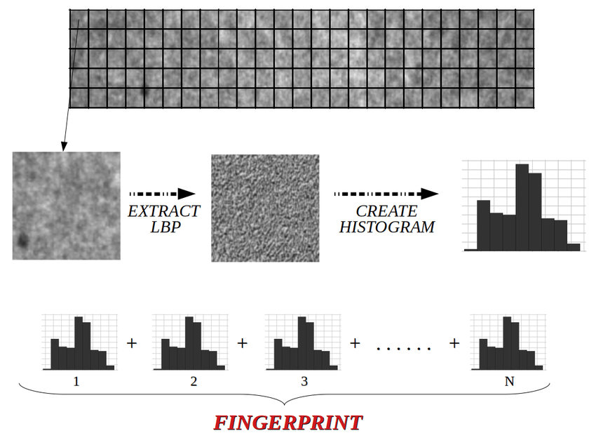
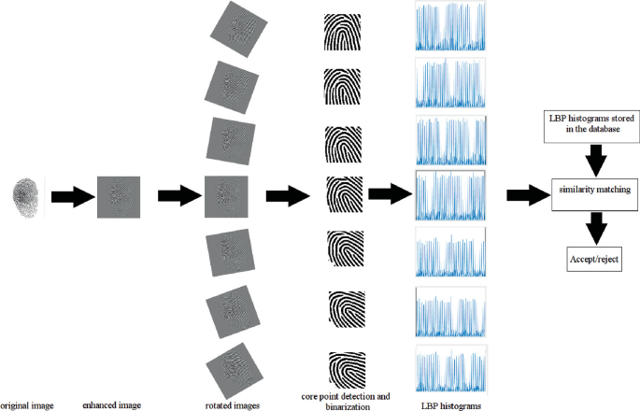
Overview of Texture-Based Feature Extraction
What is Texture-Based Feature Extraction?
Limitations
This method analyzes the texture patterns of the fingerprint to extract distinctive features for matching.
Local Binary Patterns (LBP) are commonly used to summarize local textures into a histogram, representing the fingerprint’s surface structure[5][6].
Lack of Detail: Texture-based methods may not capture fine-grained details as effectively as minutiae-based systems, which can impact precision[7].
Application: Best suited for situations where image quality is variable or when partial fingerprints need to be matched[6].
Examples of Texture- Based Techniques
Advantages
LBP can be used in combination with other techniques like Gabor filters or Fourier Transform for improved feature extraction.
Research has shown that texture-based methods can achieve high recognition rates, especially when combined with other preprocessing and feature extraction techniques [5][7].
Robustness: Less sensitive to noise and variations in image quality, making them suitable for partial or latent fingerprints[6].
Simplicity: Easier to implement compared to minutiae-based extraction, often requiring fewer preprocessing steps[5].

Slide 6
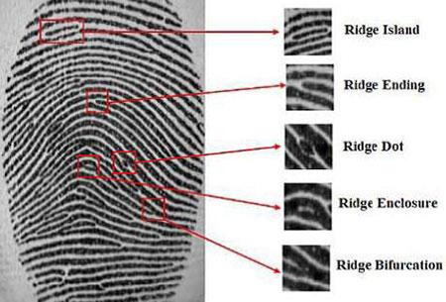
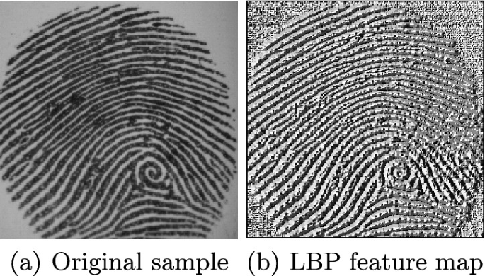
Comparison of Extraction Methods
Minutiae-Based Extraction
Texture-Based Extraction
Minutiae-Based Extraction
Strengths
Strengths
High precision and accuracy in identifying unique fingerprints.
Effective for high-quality images and matching where detailed minutiae points are visible[1].
More resilient to variations in image quality and partial fingerprints.
Easier to implement and requires fewer preprocessing steps compared to minutiae extraction [5].
Weaknesses
Weaknesses
Sensitive to noise and poor image quality.
Requires thorough preprocessing for optimal results[3].
Lacks the ability to capture fine details as accurately as minutiae-based methods, potentially affecting precision [7].
Texture-Based Extraction
When to Use Each Method
Minutiae-Based: Best suited for controlled environments with good-quality fingerprint images.
Texture-Based: Ideal for applications where fingerprint quality may vary, or for partial fingerprint matching[1].

Slide 7
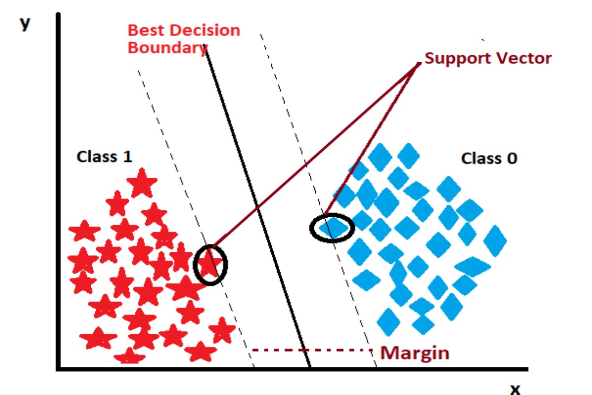
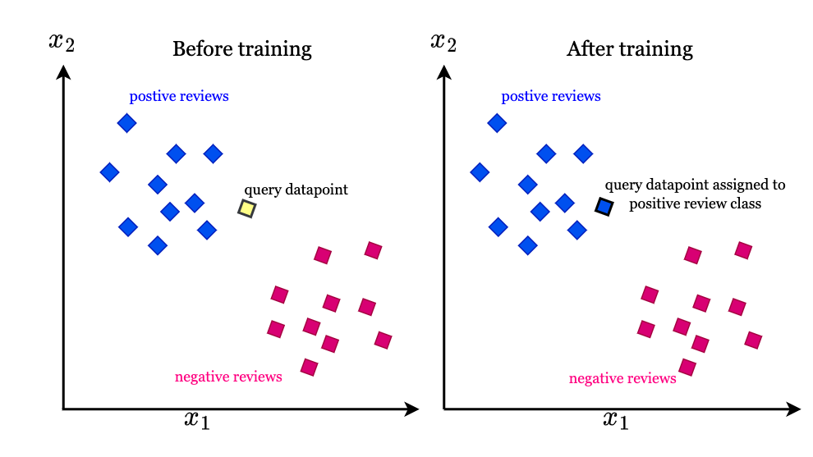
Overview of Classification Methods
Classification in Fingerprint Recognition
Applications and Use Cases
Classification is the process of categorizing fingerprint data based on extracted features.
Commonly used classifiers include Support Vector Machines (SVM) and k-Nearest Neighbors (k-NN), which help in matching fingerprint templates to stored data.
SVM is preferred when high accuracy and robustness are required, especially with minutiae-based feature data or with high-dimensional data[8][10].
k-NN is often used for simpler tasks or smaller datasets where speed is important[9].
SVM (Support Vector Machines)
K-NN (k-Nearest Neighbors)
Functionality: SVM constructs hyperplanes to separate data points into different classes. It is well-suited for high-dimensional data and provides effective classification even with complex patterns.
Advantages: High accuracy and generalization capabilities. Ideal for handling minutiae-based features due to their high-dimensional nature. [8]
Challenges: Computationally intensive, especially for large datasets.
Functionality: A simple, distance-based classifier that assigns a class based on the majority of the nearest neighbors to a data point.
Advantages: Easy to implement and understand. Suitable for small to medium-sized datasets[9].
Challenges: Becomes slower and less efficient as dataset size increases. Sensitive to the choice of k and the distance metric used.
SVM ->
KNN ->

Slide 8
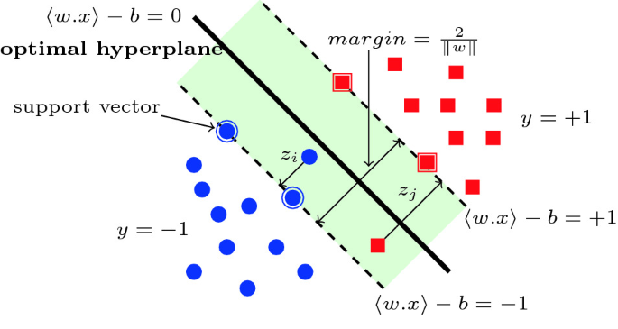
SVM In Detail
What are Support Vector Machines (SVM)
Applications in Fingerprint Recognition
Limitations
SVM is a supervised machine learning algorithm that works by finding the optimal hyperplane to classify data points into distinct categories.
Highly effective for fingerprint recognition, particularly for complex and high-dimensional data like minutiae-based features[8].
Ideal for classifying minutiae-based features where feature space is complex.
Has been shown to achieve high recognition rates when combined with advanced extraction methods like Harris-SURF​.
Computationally intensive for very large datasets.
Requires careful selection of kernel functions and parameters for optimal performance.
How SVM Works
Strengths
High Accuracy: Excellent performance with both linear and non-linear separable data.
Scalability: Works well with large datasets when computational resources are sufficient.
Robustness: Handles noisy and high-dimensional datasets effectively [10].
Data Mapping: Maps input data into a higher-dimensional space using kernel functions (e.g., linear, polynomial, RBF).
Hyperplane Construction: Finds the decision boundary that maximizes the margin between data points of different classes.
Classification: Assigns data points to classes based on their position relative to the hyperplane[8].

Slide 9
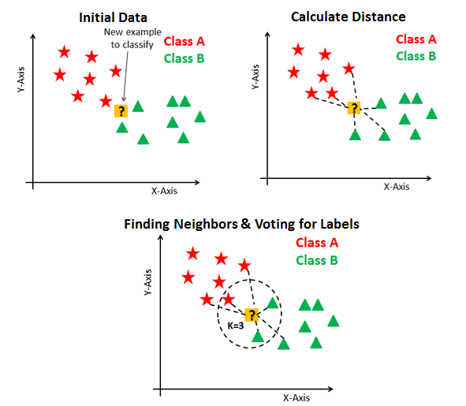
k-NN In Detail
What is k-Nearest Neighbors (k-NN)?
Applications in Fingerprint Recognition
Limitations
k-NN is a non-parametric, distance-based classification algorithm used to assign data points to a class based on the majority of their k nearest neighbors.
Frequently used for fingerprint recognition due to its simplicity and effectiveness in texture-based feature classification[9].
Computationally Intensive: Slower for large datasets due to distance calculations.
Choice of k: Performance is highly sensitive to the selection of k and the distance metric used.
Data Scaling: Requires normalization of data for meaningful distance comparisons [9].
k-NN is often applied to texture-based features such as Local Binary Patterns (LBP) or Fourier Transform outputs, where the feature space is less complex [10].
Performs well in smaller datasets or applications where quick implementation is critical.
How k-NN Works
Distance Calculation: Computes the distance between the test point and all points in the training dataset using metrics like Euclidean distance.
Neighbor Selection: Selects the closest k neighbors to the test point.
Class Assignment: Determines the class by majority vote among the neighbors[9][10].
Strengths
Simple and Intuitive: Easy to implement and interpret, with no need for a training phase.
Versatile: Can handle multi-class problems effectively​.

Slide 10
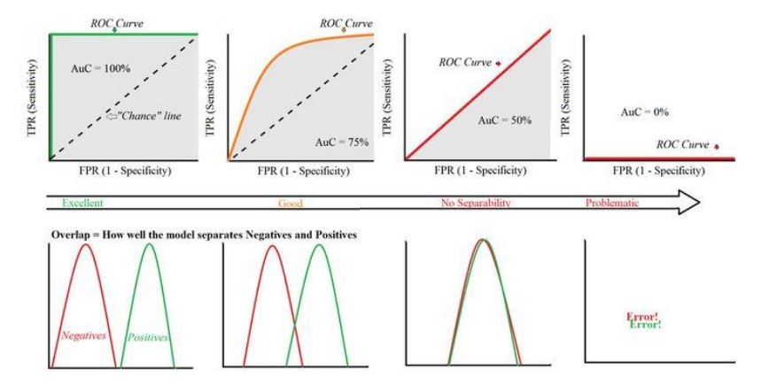
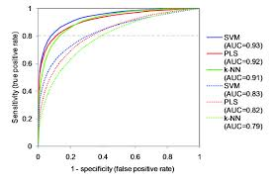
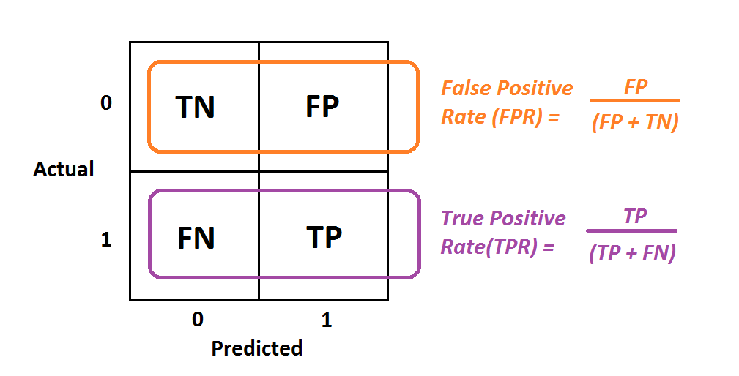
Performance Metrics in Biometric Systems
Why Performance Metrics Matter
Key Metrics in Fingerprint Recognition
Evaluation metrics are crucial for assessing the effectiveness and reliability of fingerprint recognition systems.
Metrics provide insights into how well feature extraction and classification methods perform in real-world scenarios[5][10].
Accuracy: Measures the proportion of correctly identified fingerprints among all samples. Reflects overall system reliability[5].
True Positive Rate (TPR): Also called sensitivity; indicates the ability to correctly identify matching fingerprints.
False Positive Rate (FPR): Measures non-matching fingerprints that are incorrectly classified as matches, affecting error tolerance [10].
Receiver Operating Characteristic (ROC) Curve: Visualizes the trade-off between TPR and FPR, providing a comprehensive understanding of system effectiveness.
Relationships between ROC and data distributions
Example ROC Curve
FPR & TPR

Slide 11
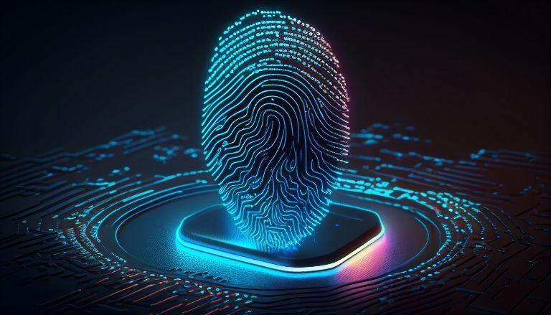
Conclusion
Performance Insights
The choice of extraction and classification method significantly impacts system accuracy, error rates, and real-world applicability.
Advanced methods like Harris-SURF combined with SVM excel in challenging conditions but come with higher computational costs​.
Summary of Key Findings
Minutiae-Based Extraction: Offers high precision and accuracy. Best suited for high-quality fingerprint images but requires extensive preprocessing.
Texture-Based Extraction: Can handle noise and partial fingerprints. Simpler to implement but less detailed than minutiae-based methods.
SVM: Ideal for handling high-dimensional, complex datasets like minutiae-based features, delivering high accuracy.
k-NN: Efficient for smaller datasets and texture-based features but less effective for large or noisy datasets.
Future Implications
Hybrid approaches combining minutiae and texture-based features could enhance systems effectiveness and adaptability.
Further research is needed to optimize methods for low-quality fingerprints and large-scale datasets.

Slide 12
References
A. Jain, Lin Hong and R. Bolle, "On-line fingerprint verification," in IEEE Transactions on Pattern Analysis and Machine Intelligence, vol. 19, no. 4, pp. 302-314, April 1997
https://doi.org/10.1109/34.587996
Bansal, R., et al. (2011). Minutiae Extraction from Fingerprint Images - A Review. arXiv.
https://arxiv.org/abs/1201.1422
F Shafait and T. M. Breuel, "The Effect of Border Noise on the Performance of Projection-Based Page Segmentation Methods," in IEEE Transactions on Pattern Analysis and Machine Intelligence, vol. 33, no. 4, pp. 846-851, April 2011, https://doi.org/10.1109/TPAMI.2010.194
Bakheet, S., Al-Hamadi, A., & Youssef, R. (2022). A Fingerprint-Based Verification Framework Using Harris and SURF Feature Detection Algorithms. Applied Sciences, 12(4), 2028. https://doi.org/10.3390/app12042028
T. Ojala, M. Pietikainen and T. Maenpaa, "Multiresolution gray-scale and rotation invariant texture classification with local binary patterns," in IEEE Transactions on Pattern Analysis and Machine Intelligence, vol. 24, no. 7, pp. 971-987, July 2002
https://doi.org/10.1109/TPAMI.2002.1017623
Maltoni, D., et al. (2009). Handbook of Fingerprint Recognition. Springer.
https://nguyenthihanh.wordpress.com/wp-content/uploads/2015/08/handbook-of-fingerprint-recognition.pdf
Cappelli, R., et al. (2007). Fingerprint verification competition 2006. Biometric Systems Journal.
https://doi.org/10.1016/S0969-4765(07)70140-6
Vapnik, V. (1995). The Nature of Statistical Learning Theory. Springer.
https://doi.org/10.1007/978-1-4757-2440-0
T. Cover and P. Hart, "Nearest neighbor pattern classification," in IEEE Transactions on Information Theory, vol. 13, no. 1, pp. 21-27, January 1967
https://doi.org/10.1109/TIT.1967.1053964
El-Abed, Mohamad & Giot, Romain & Charrier, Christophe & Rosenberger, Christophe. (2010). Evaluation of Biometric Systems: An SVM-Based Quality index. Norsk informasjonssikkerhetskonferanse (NISK).
https://www.researchgate.net/publication/257365345_Evaluation_of_Biometric_Systems_An_SVM-Based_Quality_index

